Slide 1
CPU Scheduling Schemes
Daniel Nedrow

Slide 2
Purpose
Examine and compare different CPU scheduling schemes
Make a determination about which scheme is superior
Audience
Operating System Design Team
Direction
Examine criteria by which we judge CPU scheduling
Give an overview comparison of 3 different schemes
First-Come, First-Served (FCFS)
Round Robin (RR)
Multi-Level Feedback Queue (MLFQ)
Give sample runs with each of the 3 schemes
Get a feel for the fairness of process selection
Examine and compare critical statistics

Slide 3
Ways to Evaluate Scheduling Schemes
Response Time: time it takes for a process to receive its very first bit of CPU service
Waiting Time: overall time a process spends waiting in the ready queue
Turnaround Time: time for a process to by fully serviced by CPU
In Addition …
Is the scheduling scheme fair?
Does it prevent a process from starvation?

Slide 4
Two General Categories of Scheduling
Non-Preemptive Scheduling
Once a process gets service from the CPU, that service continues until the process is complete
Preemptive Scheduling
A process may be interrupted before completion
A higher priority process demands attention
The current process’s time (quantum) has simply expired

Slide 5
1. First-Come, First-Served Scheduling
Processes are served in order of arrival
Non-Preemptive: each process runs to completion before yielding the CPU
The algorithm for FCFS is easy to write
Waiting time, however, is often quite long
Short processes may wait behind long processes
Very unfair (processes won’t receive timely service)
No Starvation: every process eventually served

Slide 6
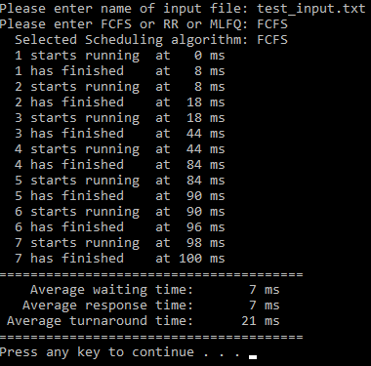
Example Run of FCFS (7 Processes)

Slide 7
2. Round Robin Scheduling
Processes served in order, but only for 1 quantum
Quantum: the length in milliseconds of CPU time slice
Amount of time a process is served before yielding CPU
Preemptive: Processes must yield when quantum expires
Average waiting time is usually still long
Response time, however, is reduced
Completely fair to all processes
No Starvation: every process is eventually served

Slide 8
Example Run of Round Robin (Same Processes as Before)

Slide 9
3. Multi-Level Feedback Queue
Processes first served in Round Robin, with short quantum
This ensures rapid response time for all newly arrived processes
Processes are then “demoted” to a lower queue
Round Robin with a longer quantum: gives more service
Finally processes are demoted to lowest queue, FCFS
Response time, waiting time generally low
Fairness
Ensures rapid response to new arrivals, longer service time to large processes (when CPU is less busy serving new arrivals)
Starvation
Starvation is possible if new arrivals hog CPU’s attention

Slide 10
Example Run of MLFQ (Same Processes)

Slide 11
Comparison of Critical Statistics
First-Come, First-Served
Average Waiting Time: 7 ms
Average Response Time: 7 ms
Average Turnaround Time: 21 ms
Round Robin
Average Waiting Time: 4.14 ms
Average Response Time: 2.43 ms
Average Turnaround Time: 18.14 ms
Multi-Level Feedback Queue
Average Waiting Time: 2.71 ms
Average Response Time: 1 ms
Average Turnaround Time: 16.71 ms

Slide 12
Conclusion …
The Multi-Level Feedback Queue (MLFQ) performed best in all 3 critical metrics of success
Particularly impressive was the 1 ms response time
The MLFQ provides good fairness to processes
Balance needs of very short and very long processes
We still need to address the issues of starvation
If CPU is inundated w/ short processes, long processes starve
We should implement an MLFQ with appropriate safeguards against starvation

